Slide 1
N8N CAPSTONE PROJECT
AI Customer Support
Automation Platform
An end-to-end n8n system for ticket intake, AI classification, routing,
resolution, and analytics — 5 workflows, 35 nodes.
Submitted by: [Kapil yadav]
Course: [B.Tech CSE]

Slide 2
PROBLEM ANALYSIS
Business Context
Growing businesses handling customer support through email or web forms struggle to scale as ticket volume increases. Manually reading, categorizing, prioritizing, and routing every request is slow, inconsistent, and error-prone — directly harming customer satisfaction and retention.
5
Independent
Workflows
35
Total
n8n Nodes
This project designs a fully automated, AI-powered customer support pipeline in n8n — receiving, understanding, routing, resolving, and reporting on tickets, with a human confirmation step kept in the loop.
6
Automated
Customer Emails
2

Slide 3
PROBLEM ANALYSIS
Stakeholders & Pain Points
Stakeholders
Key Pain Points (Before Automation)
Customers — expect quick acknowledgement & resolution
Support Agents (Tech / Billing / Sales) — need correctly triaged tickets
Support Manager — needs visibility into urgent tickets & trends
Business Owner — cares about response time & CSAT
No automatic acknowledgement — tickets sat unread for hours
Manual classification consumed agent time daily
Misrouted tickets caused rework and delay
No guaranteed escalation path for urgent issues
Inconsistent feedback collection; no weekly reporting
3

Slide 4
PROBLEM ANALYSIS
Project Objectives
1
2
3
Capture Instantly
Classify with AI
Route & Escalate
Log every incoming request into a central system of record within seconds of submission.
Use an LLM to assign Category, Priority, and Sentiment automatically — no manual triage.
Send tickets to the correct team; escalate High-priority tickets straight to a manager.
4
5
6
Communicate Proactively
Collect Feedback
Report Automatically
Notify customers at acknowledgement, resolution, and feedback stages.
Gather structured customer feedback tied to each ticket.
Generate an AI-written weekly performance summary for management.
4

Slide 5
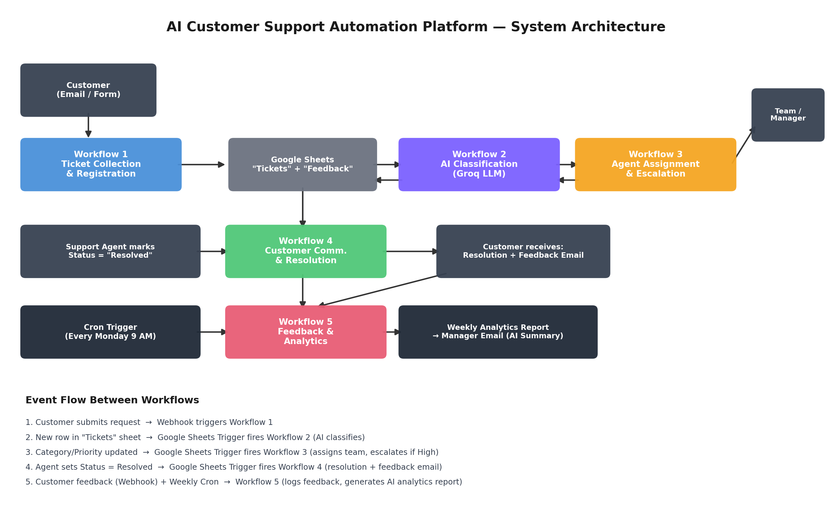
WORKFLOW ARCHITECTURE
System Architecture
5

Slide 6
WORKFLOW ARCHITECTURE
Workflow Interaction & Event Flow
Workflow | Trigger Type | Writes To
1. Ticket Collection & Registration | Webhook (POST) | Tickets sheet + confirmation email
2. AI Classification & Prioritization | Google Sheets Trigger (row added) | Tickets sheet (Category, Priority)
3. Agent Assignment & Escalation | Google Sheets Trigger (row updated) | Assigned Team + team/manager email
4. Customer Communication & Resolution | Google Sheets Trigger (row updated) | Resolution + feedback emails
5. Feedback & Analytics | Webhook + Weekly Cron | Feedback sheet + manager report email
Event Flow
Customer submits → Webhook triggers Workflow 1
New row → Workflow 2 classifies with AI
Category/Priority set → Workflow 3 assigns & escalates
Agent sets Resolved → Workflow 4 notifies customer
Feedback + weekly Cron → Workflow 5 reports to manager
6

Slide 7
IMPLEMENTATION
Workflow 1 & 2
Ticket Collection & Registration
AI Classification & Prioritization
PURPOSE
PURPOSE
Capture incoming customer requests and register them as tickets.
Automatically classify each new ticket using an LLM.
NODES
NODES
Webhook Trigger → Set (Prepare Data) → IF (Attachment?) → Google Sheets (Append) → Gmail (Confirmation)
Sheets Trigger (row added) → IF (Not Classified) → Groq Llama 3.3 → Code (Parse JSON) → Sheets (Update)
KEY LOGIC
KEY LOGIC
A unique Ticket ID is generated via a timestamp expression. Both IF branches converge before the confirmation email step. (5 nodes)
A system prompt forces strict JSON output (Category, Priority, Sentiment, Reason). The Code node safely parses it with a fallback on failure. (5 nodes)
7

Slide 8
IMPLEMENTATION
Workflow 3 — Agent Assignment & Escalation
Purpose: Route each classified ticket to the correct team and escalate urgent tickets to the manager.
NODES (9 total)
Sheets Trigger → IF (Not Assigned) → Switch (by Category) → 4× Gmail (team notification) → Sheets (Update Assigned Team) → IF (High Priority) → Gmail (Manager Escalation)
Technical Team
Billing Team
Sales Team
General Queue
If Priority = High → Manager gets an urgent escalation email
Key logic: the Switch node's 4 outputs converge into a single Update node before branching again on Priority — demonstrating both conditional branching and multi-path convergence.
8

Slide 9
IMPLEMENTATION
Workflow 4 & 5
Customer Communication & Resolution
Feedback & Analytics
PURPOSE
PURPOSE
Notify the customer when their ticket is resolved and request feedback.
Collect structured feedback and generate a scheduled AI analytics report.
NODES
NODES
Sheets Trigger (row updated) → IF (Status=Resolved) → Gmail (Resolution) → Wait (24h) → Gmail (Feedback Request) → Sheets (Mark Notified)
Branch A: Webhook → Set → Sheets (Append Feedback). Branch B: Weekly Cron → Read Sheets → Merge → Code (Aggregate) → AI Summary → Gmail (Report)
KEY LOGIC
KEY LOGIC
The Wait node demonstrates time-delayed automation. Marking the row prevents duplicate emails on future edits to the same ticket. (6 nodes)
Two independent triggers in one workflow. The Code node computes counts, category/priority breakdowns, and average rating before the AI writes the summary. (10 nodes)
9

Slide 10
IMPLEMENTATION
Advanced Features Implemented
1
AI-Powered Decision Making
2
Human Approval Step
Groq Llama 3.3 classifies tickets and writes the weekly summary report.
Workflow 4 fires only after an agent manually marks a ticket “Resolved.”
3
Conditional Branching
4
Webhook Triggers
IF nodes + a 4-way Switch node route logic throughout the pipeline.
Workflow 1 (ticket intake) and Workflow 5 (feedback intake).
5
Scheduled Workflow (Cron)
6
Error Handling & Fallback
Workflow 5 runs automatically every Monday at 9:00 AM.
AI JSON parsing wrapped in try/catch with safe default values.
7
Logging & Audit Trail
8
Idempotency Guards
Every ticket's full lifecycle is persisted as rows in Google Sheets.
“Already classified/assigned” checks prevent duplicate processing.
10

Slide 11
RESULTS
Testing Summary & Deliverables
End-to-End Test Results
Deliverables
Test Case | Status
Ticket submission → confirmation email | Pass
AI classification accuracy | Pass
Correct team routing | Pass
High-priority manager escalation | Pass
Resolution + feedback request emails | Pass
Feedback logging via webhook | Pass
Weekly AI analytics report | Pass
5 exported n8n workflow JSON files
Full workflow documentation (project report)
System architecture diagram
5–10 minute live demo video
GitHub repository with README
This presentation deck (12 slides)
11

Slide 12
CONCLUSION & FUTURE SCOPE
A Complete, Production-Style
Support Automation Pipeline
Five independently testable workflows, 35 total nodes, and end-to-end AI decision-making reduce manual triage to zero while keeping a human-in-the-loop resolution checkpoint.
Future Enhancements
Move from polling triggers to a real database with native change webhooks
Add Slack / Teams integration alongside email
Auto-parse customer feedback replies using AI
Add an Error Trigger workflow for centralized failure alerts
Build a live analytics dashboard on top of the existing data
Thank You

